Slide 1


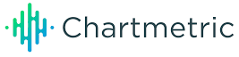
Artist Career Momentum Analysis
Uncovering the Trajectory of Success in the Music Industry
Tyla, Paul Russell & Lisa Loeb: A Comparative Study
Presented by: Project #1 Team 7
Date: May 2024
Alisha Outridge, Angel Alcantara, D. James Prince, Ezra Timmons, Nico Contreras, and Xiwu Dai
Notes:
Project #1 Team 7 - Google Docs
5-10 Min 2 mins for Questions and Comments

Slide 2

Agenda
Summary
Approach and Methodology
Artist Career Overview/Analysis - Paul Russell
Artist Career Overview/Analysis - Tyla
Artist Career Overview/Analysis - Lisa Loeb
Conclusion
Notes:
Project #1 Team 7 - Google Docs
Executive Summary (James)
Project overview: Analyzing artist career momentum using Chartmetric API
Goals: Investigate fan growth, career trajectory, and impact of viral hits
Approach and Methodology (Nico+Ezra speak to this slide)
Defining career momentum and fan growth
Selecting artists for analysis (Tyla and Paul Russell)
Visualizations and storytelling approach
The data collection, cleanup, and exploration processes Nico
Artist Career Overview-Milestone Slide (Alisha)
Music history slide: Career trajectory, viral hit, and second hit
Fan growth over time (social media and streaming)
Career momentum before and after viral hit
Artist Career Overview/Analysis - Paul Russell (Nico)
Music history slide: Career trajectory, viral hit, and second hit
Fan growth over time (social media and streaming)
Career momentum before and after viral hit
Summary of observations and findings
Artist Career Overview/Analysis - Tyla (Ezra)
Music history slide: Career trajectory, viral hit, and second hit
Fan growth over time (social media and streaming)
Career momentum before and after viral hit
Summary of observations and findings
Artist Career Overview/Analysis - Lisa Loeb (Alisha) Music history slide: Career trajectory, viral hit, and second hit
Fan growth over time (social media and streaming)
Career momentum before and after viral hit
Summary of observations and findings
Conclusion (Xiwu)
Recap of project goals and achievements
Final thoughts and takeaways from the analysis

Slide 3

Summary: Analyzing artist career momentum using Chartmetric API
Our Project is focused on analyzing the career trajectories of three viral artists, Tyla, Paul Russell and Lisa Loeb, particularly how their streaming and social media activities align with their overall music career success from 2022 to 2024. All of these artists had a viral big hit that propelled them into successful careers and our analysis suggests that they continue to benefit from it today. Utilizing data provided by Chartmetric, we aimed to uncover patterns & correlations that highlight the impact of these activities on their overall music career success.
Research Question:
How do Tyla, Paul Russell and Lisa Loeb’s streaming metrics (e.g., Spotify, YouTube) align with their social media presence and engagement (e.g., Instagram, Twitter, TikTok)?
Notes:
Project #1 Team 7 - Google Docs
This project aims to analyze the career trajectories of three artists: Tyla Laura Seethal, Paul Russell, and Lisa Loeb, by examining their streaming and social media activities from 2022 to 2024. Utilizing data provided by Chartmetric, we aim to uncover patterns and correlations that highlight the impact of these activities on their overall music career success. Tyla and Paul experienced significant boosts in their careers due to viral hits and have since released additional hits, while Lisa Loeb, having sustained a long career since her pre-social media era hit, provides a contrast in adapting to the evolving digital landscape.
Our goal is to determine whether these artists are on the path to long-term success or if they risk being "one-hit wonders."

Slide 4

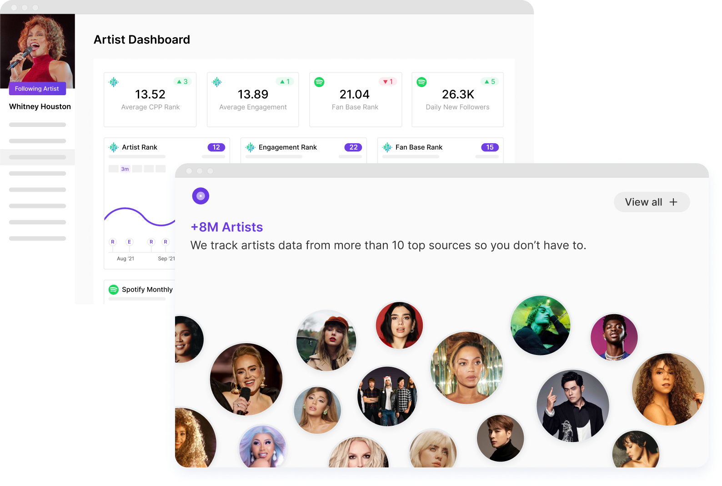
Approach and Methodology
Defining Career Momentum and Fan Growth
Career momentum: Trajectory of an artist's success over time, including chart performance, streaming numbers, and social media engagement.
Instagram Fan growth: Increase in an artist's fan base, measured through social media followers, streaming numbers, and concert ticket sales.
Selecting Artists for Analysis
Tyla: Emerging artist with a recent viral hit, analyzing career momentum and fan growth.
Paul Russell: Established artist with a consistent track record, analyzing the evolution of career momentum and fan growth.
Lisa Loeb: Veteran artist who transitioned from early fame with a pre-social viral hit to adapting successfully in today's digital music industry, maintaining relevance by diversifying into children’s music & her own eyewear line.
Visualizations and Storytelling Approach
Combining charts, graphs, and images to visualize fan growth and career momentum.
Highlighting key milestones of the artist’s career like viral hits & album releases to illustrate trends.
Notes:
Project #1 Team 7 - Google Docs
Chartmetric is the all-in-one platform for artists and music industry professionals, providing comprehensive streaming, social, and audience data for everyone to create successful careers in music.
Even when we looked at other artists like Los Del Rio who made Macarena and Vanilla Ice who made Ice Ice Baby this same pattern was observed.

Slide 5

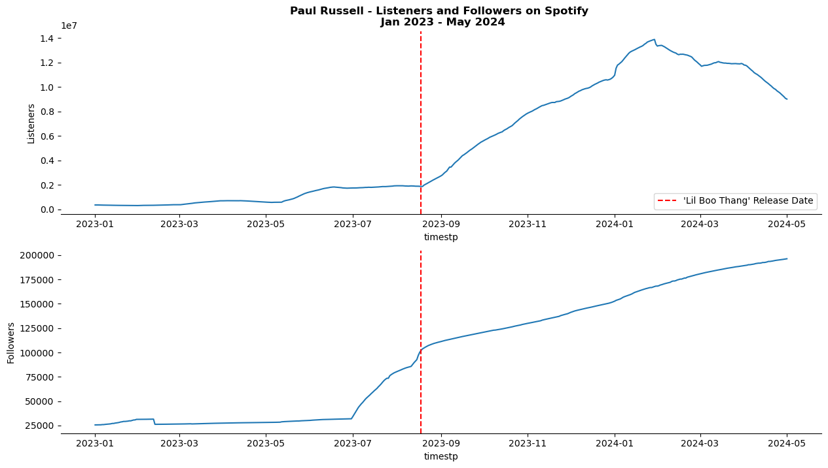
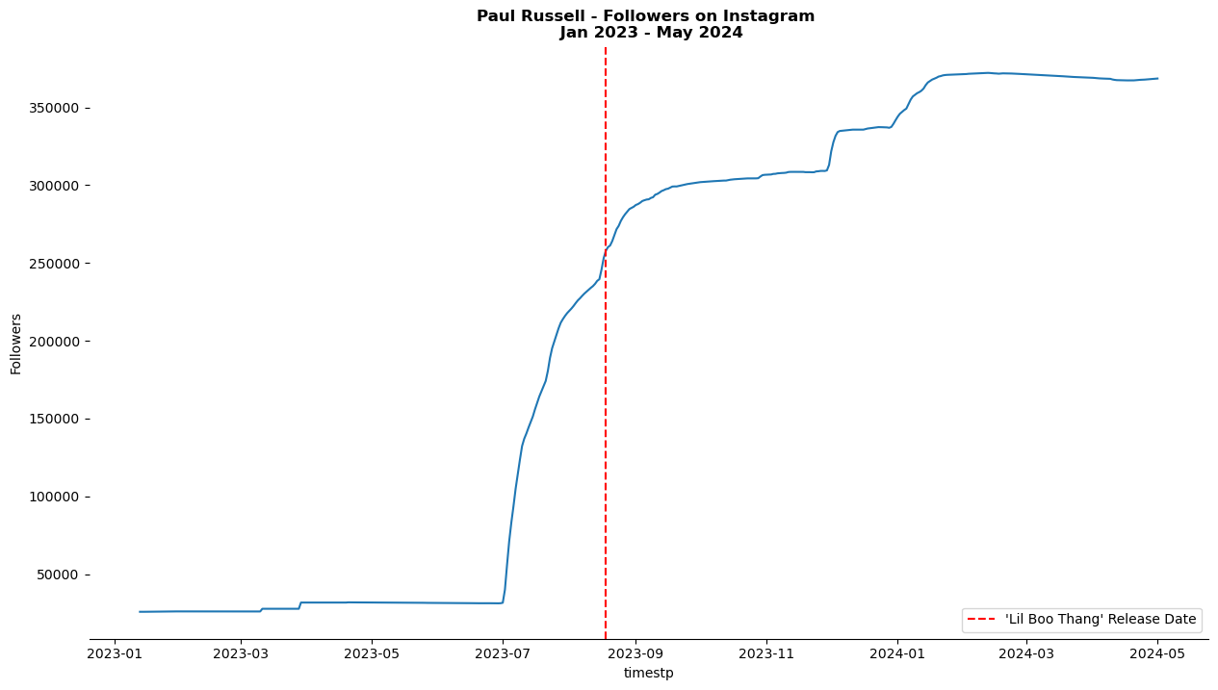
Artist Career Overview:
Paul Russell
Inflection Point and Pre-Release Strategy
An inflection point in streaming and social media engagement occurs shortly before the song is released. This spike is likely due to pre-release promotional activities.
The artist shared his song on TikTok prior to its official release, leveraging the platform's viral potential to boost early engagement and create anticipation.
Post-Q1 2024 Plateau
After Q1 2024, there is a noticeable plateau in engagement across all platforms. This suggests that while the initial momentum from the release drives significant engagement, sustaining that momentum over the long term proves challenging.
CPP Rank Stability
According to the CPP Rank (Appendix 1), the artist's ranking remains steady after the viral hit, with only a slight decrease observed in May 2024. This indicates that while the viral success helped maintain a higher baseline of popularity, the initial peak was not fully sustained.
Notes:
Project #1 Team 7 - Google Docs
Inflection Point and Pre-Release Strategy:
An inflection point in streaming and social media engagement occurs shortly before the song is released. This spike is likely due to pre-release promotional activities.
The artist shared his song on TikTok prior to its official release, leveraging the platform's viral potential to boost early engagement and create anticipation.
Post-Q1 2024 Plateau:
After Q1 2024, there is a noticeable plateau in engagement across all platforms. This suggests that while the initial momentum from the release drives significant engagement, sustaining that momentum over the long term proves challenging.
CPP Rank Stability:
According to the CPP Rank (Appendix 1), the artist's ranking remains steady after the viral hit, with only a slight decrease observed in May 2024. This indicates that while the viral success helped maintain a higher baseline of popularity, the initial peak was not fully sustained.

Slide 6

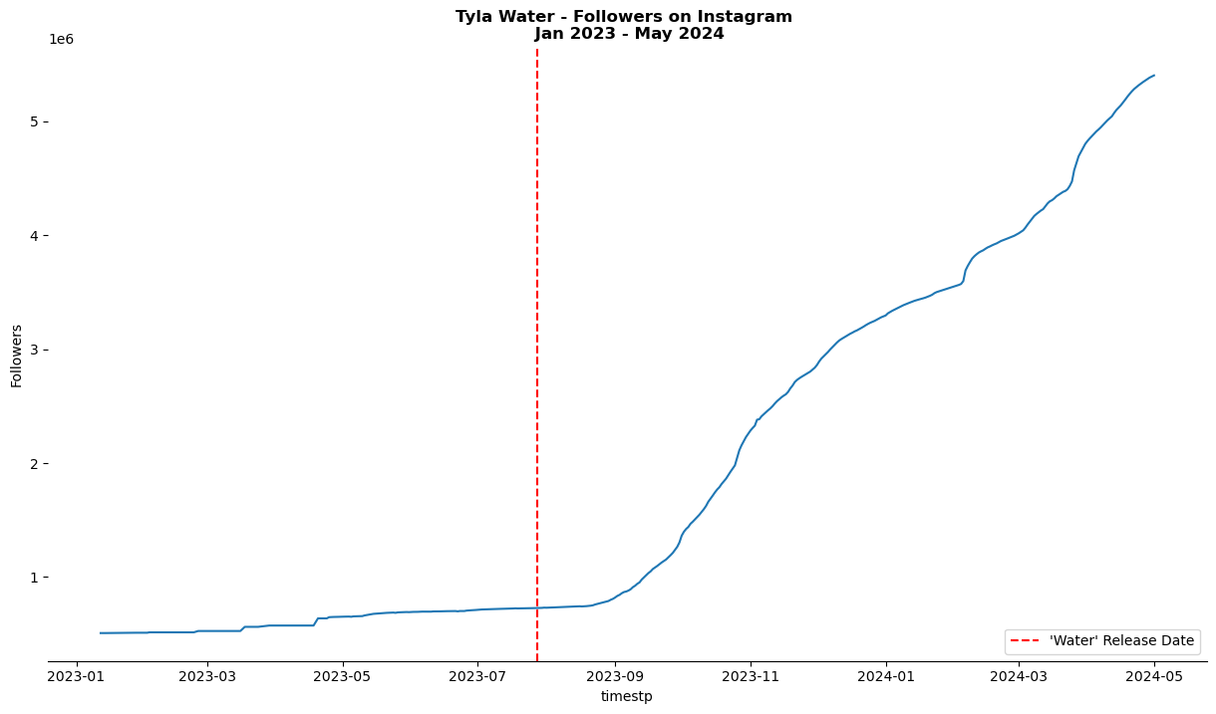
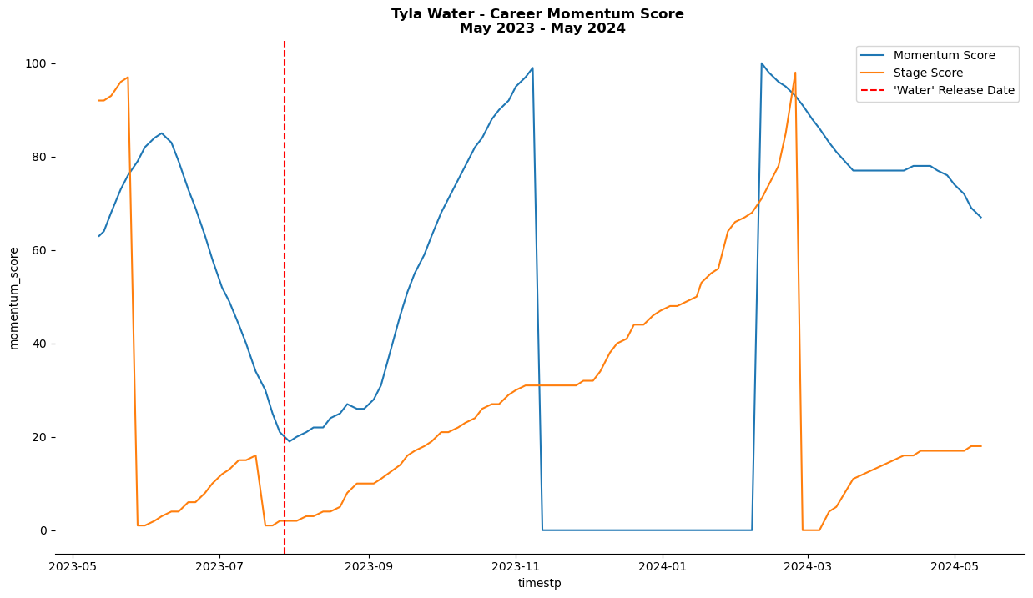
Artist Career Overview:
Tyla
Increase in Instagram Followers
In September 2023, Tyla experienced a significant increase in Instagram followers following the release of her hit song "Water."
November 2023
November 17, 2023, remixed versions featuring Travis Scott and record producer Marshmello released.
February 2024
Won her first Grammy for Best African Music Performance
March 2024
In March 2024, announced the cancellation of the North American leg of her tour and the postponement of the European leg, citing an injury that had worsened over time.
March 19, 2024, premiered the music video for remix featuring Travis Scott.
Chartmetric Stage Score - Chartmetric Stage Score evaluates an artist's career stage based on their performance across various social media and streaming platforms.
Chartmetric Momentum Score - The Chartmetric Momentum Score measures short-term career growth and momentum, derived from the difference between the average Chartmetric Artist Score over the past 30 days and the past 60 days.
Notes:
Project #1 Team 7 - Google Docs
Interpretation:
Pre-Release Period (May 2023 - July 2023):
The momentum score is relatively high initially but begins to decline leading up to the release of 'Water' in July 2023.
The stage score increases significantly until just before the release, indicating perhaps a buildup in anticipation or promotional activities.
Post-Release Period (July 2023 - January 2024):
After the release in mid-July, both the momentum and stage scores drop sharply. The momentum score recovers slowly, while the stage score remains low until January 2024.
This period could indicate initial disappointment or less traction gained post-release.
Recovery and New Activity (January 2024 - March 2024):
The momentum score increases significantly from January to March 2024, suggesting renewed interest or successful activities.
The stage score also rises during this period, indicating new stages of career activity or performances.
Decline and Stabilization (March 2024 - May 2024):
After peaking in March 2024, both scores drop, with the stage score falling to zero and then slightly recovering, while the momentum score stabilizes at a moderate level.
Conclusion:
The graph indicates significant fluctuations in Tyla Water's career momentum, with key periods of decline post-release and recovery in early 2024. The release of 'Water' seems to have caused an initial drop in both scores, followed by a period of recovery and renewed activity in early 2024.

Slide 7

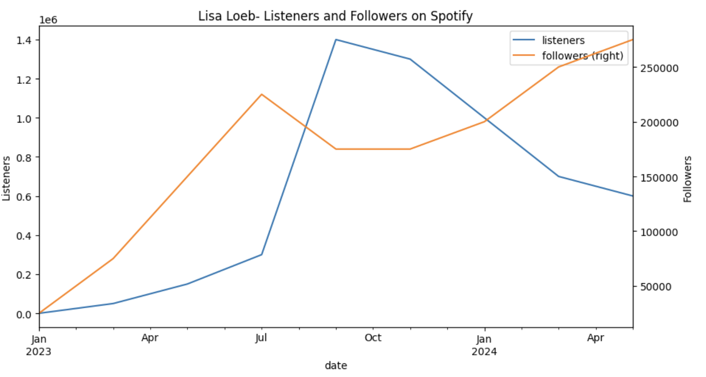
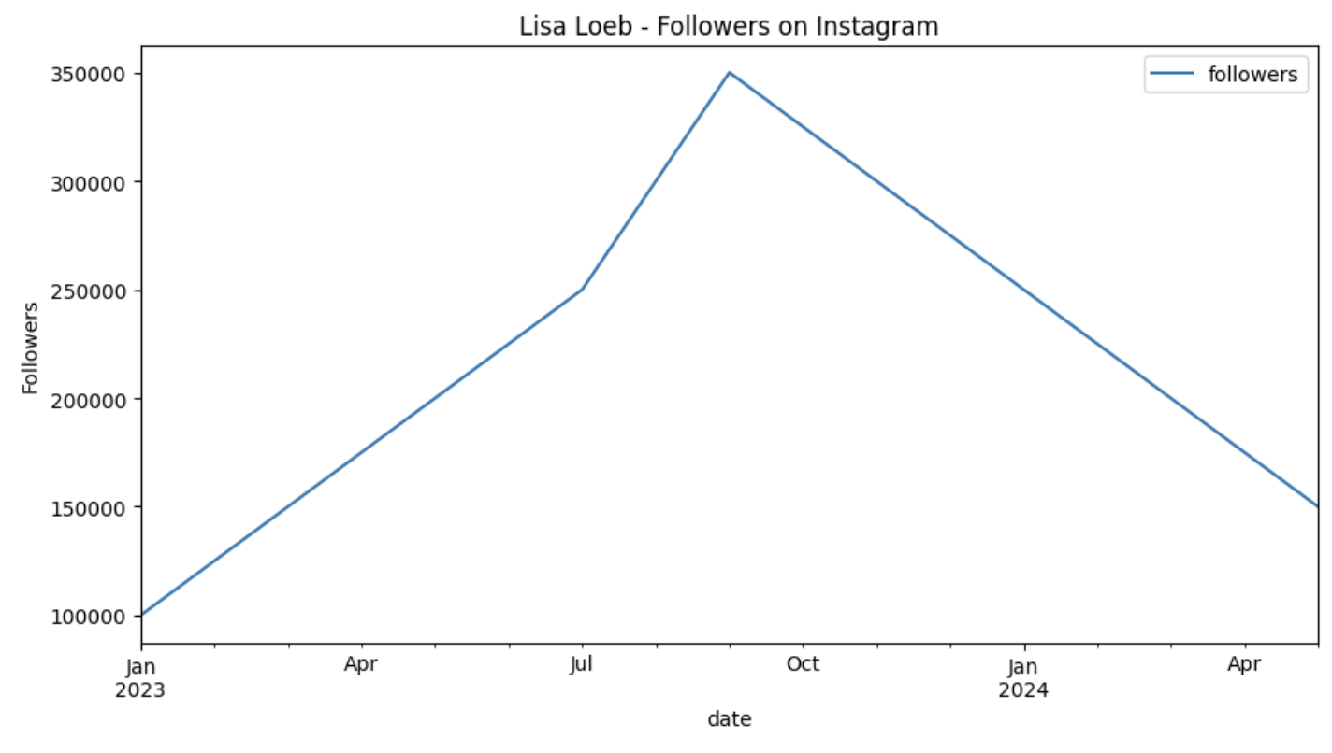
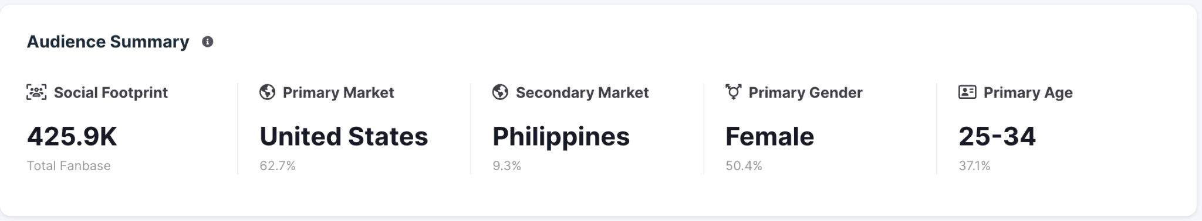
Artist Career Overview:
Lisa Loeb
Early Career & Viral Hit: Lisa Loeb's music career gained significant traction with her hit song "Stay (I Missed You)" in 1994, which was featured in the film Reality Bites. It became a No. 1 hit on the Billboard Hot 100 & she notably achieved this as an unsigned artist.
Continued Success:
Loeb debuted several albums consistently and globally from the 1990s onwards to 2024 today.
Initial albums were certified Gold. Starting with Tails in 1995 & Firecracker in 1997. Over the years, other albums were released with varying success.
Loeb won a Grammy for Best Children’s Music Album in 2016.
Data observation - There is a strong correlation between social media peaks in growth & Spotify performance growth in popularity.
Career Today: Lisa Loeb remains very active on social media & continues to perform and release music, skillfully adapting her style over the decades into children's music, her own eyewear line, Lisa Loeb Eyewear, both reflecting her signature style.
Notes:
Project #1 Team 7 - Google Docs

Slide 8

Conclusion of Analysis
Streaming metrics and social media engagement, especially TikTok and Instagram, drive success.
Successful strategies include Paul's TikTok pre-release promotion and Tyla's engaging Instagram presence.
Viral hits drive success, but long-term relevance involves overcoming audience plateau and using insights from metrics like Chartmetric.
Adapting across industries & multiple platforms is crucial for viral artists' career longevity. Lisa Loeb's seamless transition from the pre-social media era to today's digital landscape highlights the importance of adaptability for sustained relevance in the music industry.
Notes:
Project #1 Team 7 - Google Docs
Conclusion on Viral Hits:
Viral hits can act as catalysts for rapid success, significantly boosting an artist's profile and engagement metrics in the short term.
However, the data suggests that plateaus or downward trends are more likely following the initial viral success. Sustaining high levels of engagement requires ongoing effort and potentially new strategies to maintain audience interest. Even when we looked at other artists like Los Del Rio who made Macarena and Vanilla Ice who made Ice Ice Baby this same pattern was observed.

Slide 9
Appendix
Notes:
Project #1 Team 7 - Google Docs

Slide 10
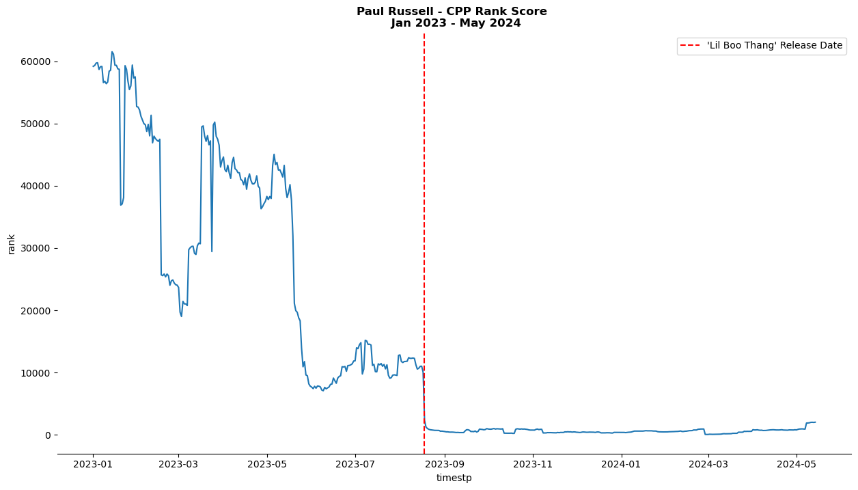
Paul Russell - CPP Ranking
(The lower the CPP rank, the better it is.)
Notes:
Project #1 Team 7 - Google Docs

Slide 11
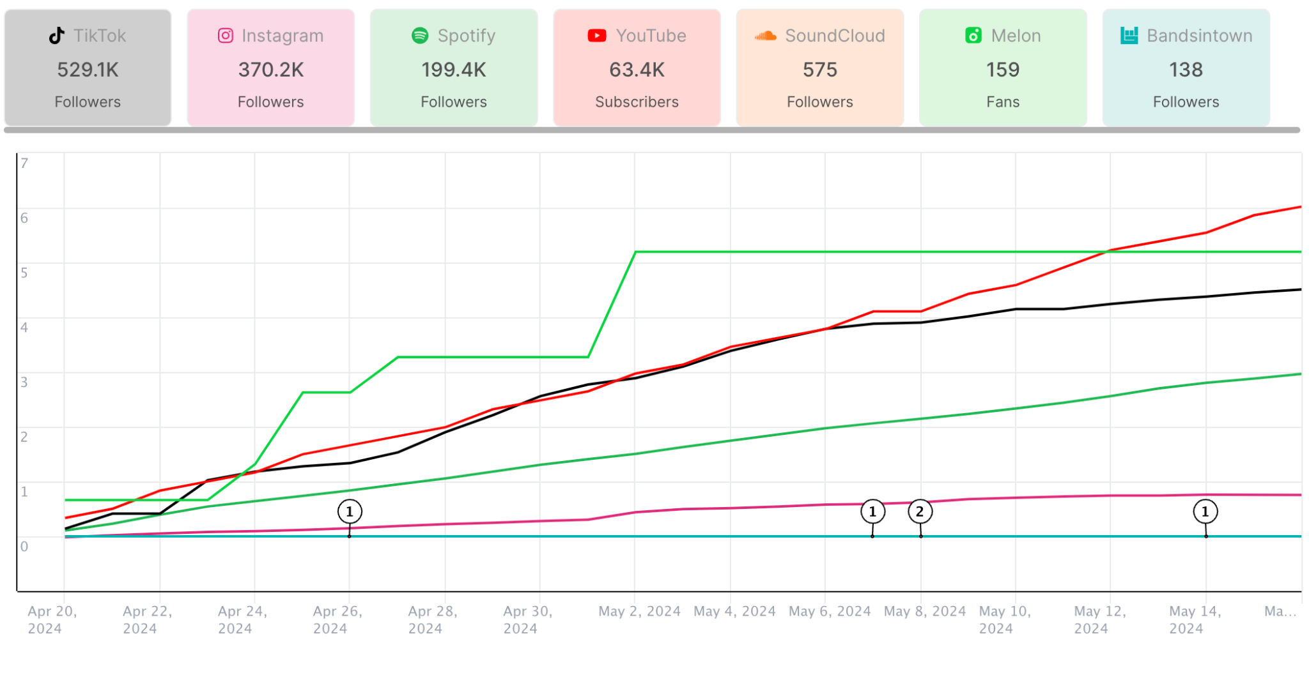
Paul Russell - Fan Base Distribution Summary

Slide 12
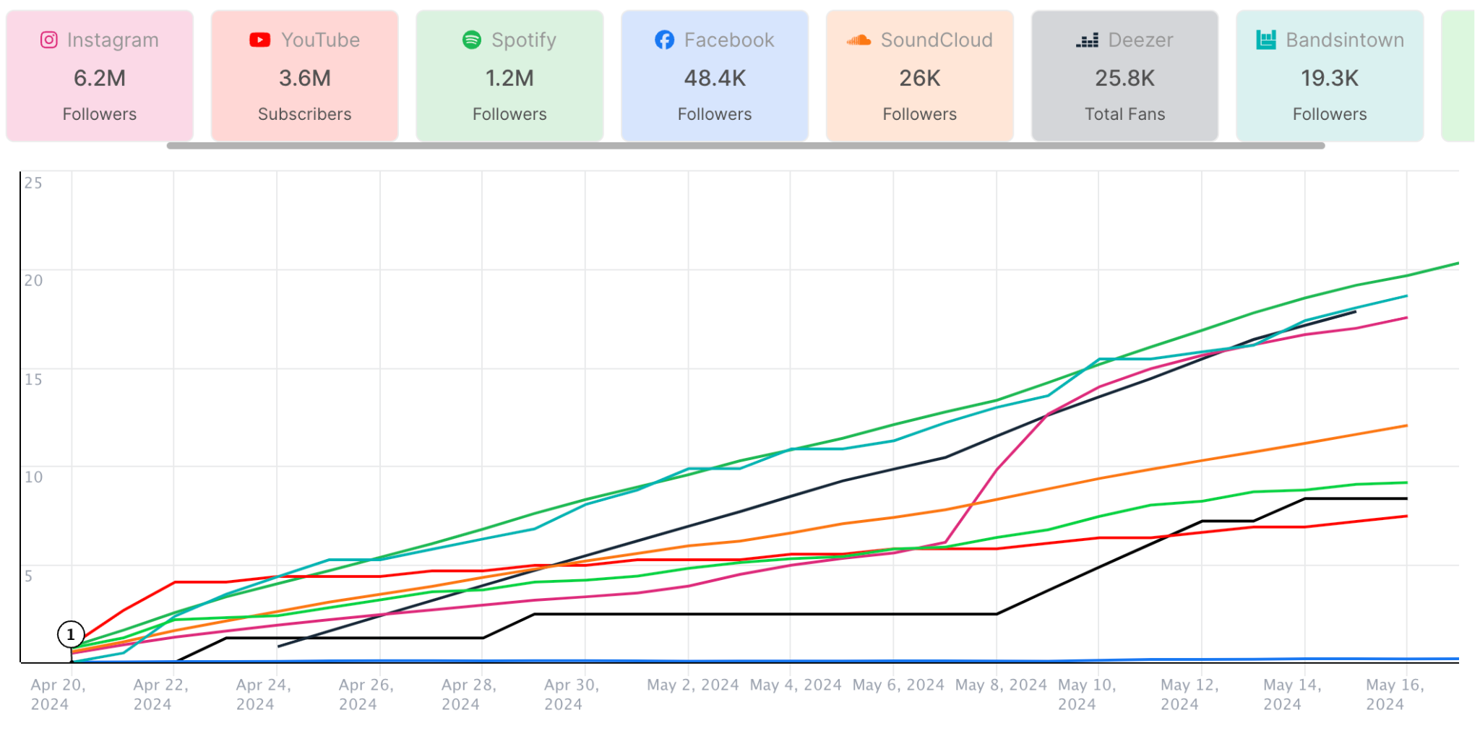
Tyla - Fan Base Distribution Summary

Slide 13
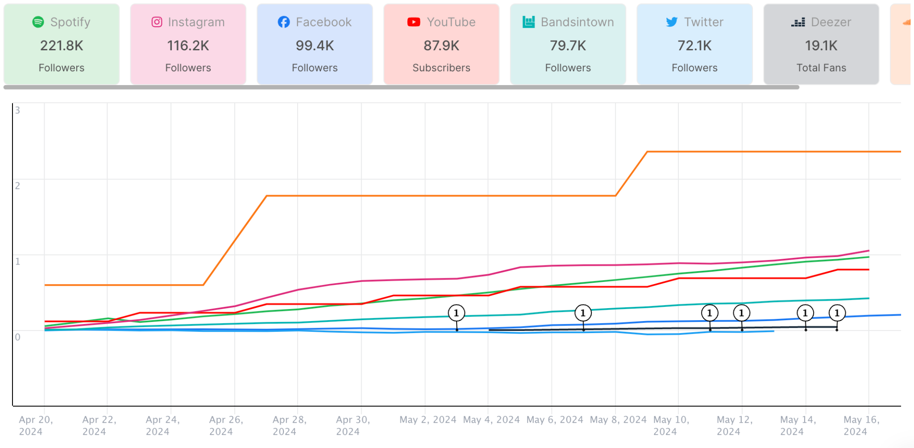
Lisa Loeb - Fan Base Distribution Summary

